Slide 1
Docker Workflows with Visual Studio
Steve Lasker
Program Manager
Azure Developer Experiences
@SteveLasker

Slide 2


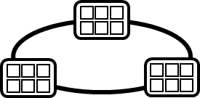

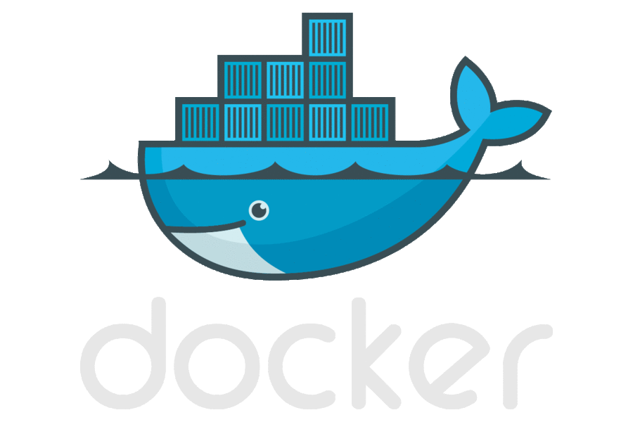




Containerized Workflow
Visual Studio Team Services
Container Service
2.
3.
4.
5.
Run, Manage
Service Fabric
Source Code Control
(SCC)
Build/CI,
Integrate,
Test
CD, Deploy
Batch
Production
environments
App Services
Azure Container Registry
Coming soon
Push
Code
…
Inner-Loop
6.
…
1.
Run
Monitor and Diagnose
Code
Validate
Outer-Loop
Debug

Slide 3

Some Assembly Required
Batteries are included

Slide 4
Demo

Slide 5
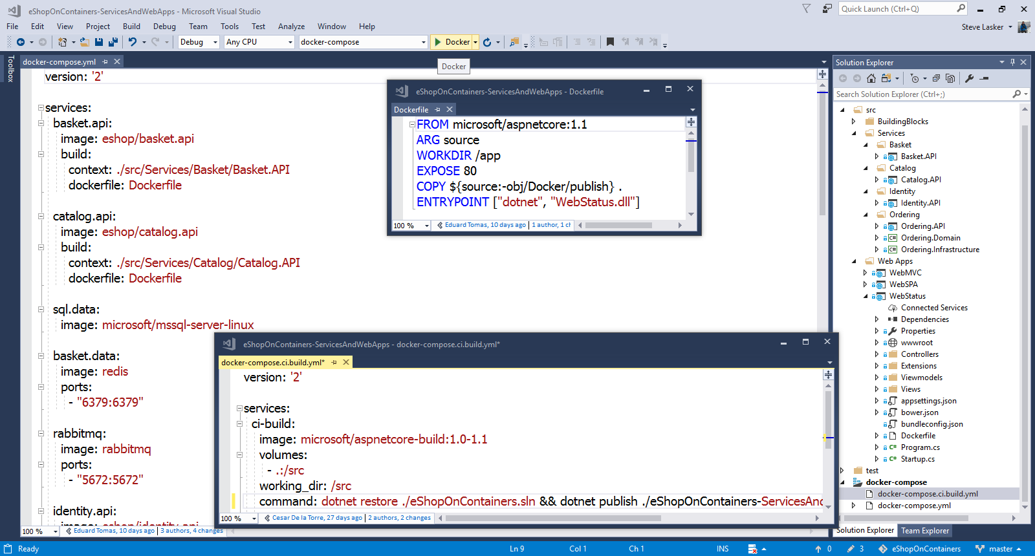
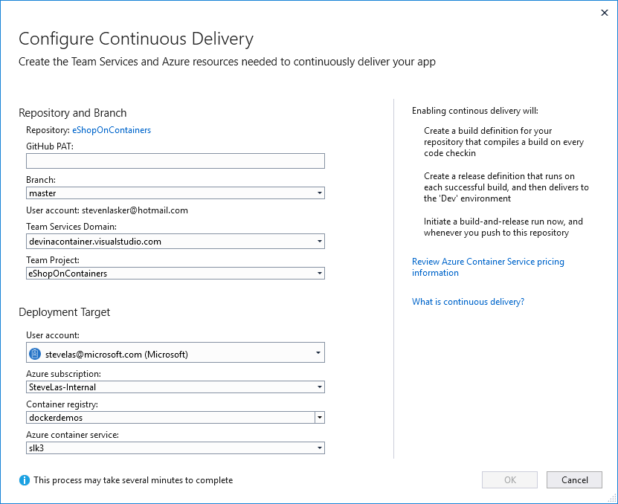
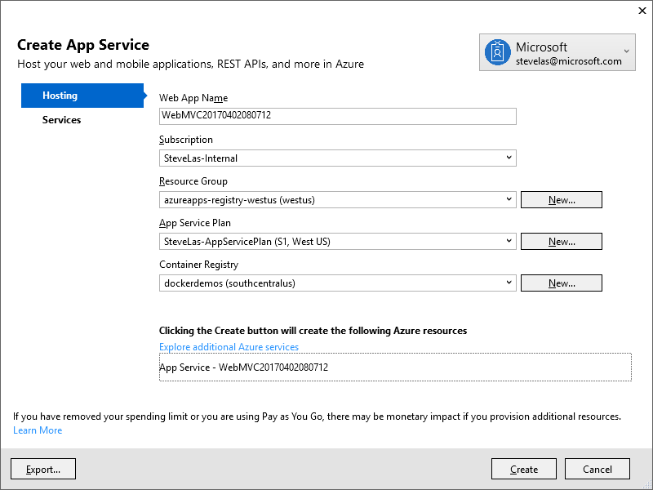
Visual Studio 2017 Container Tools
Run, Debug, Test Web & Console apps in docker containers
.NET FX w/Windows Server .NET Core w/Nano Server or Linux
Multi Container Debugging
Debug and Release configurations
Edit & Refresh of code
Scaffolds docker assets
Dockerfile, docker-compose.yml
visualstudio.com

Slide 6
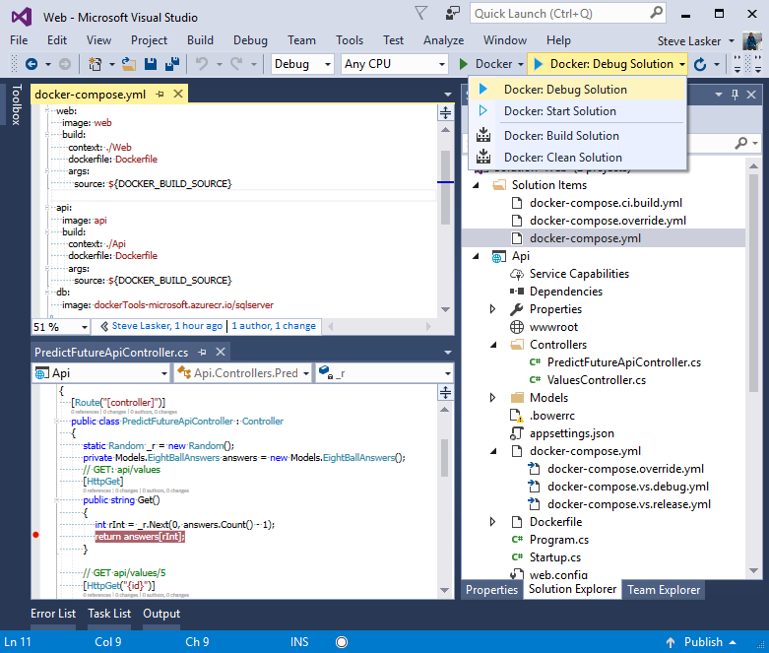

Slide 7
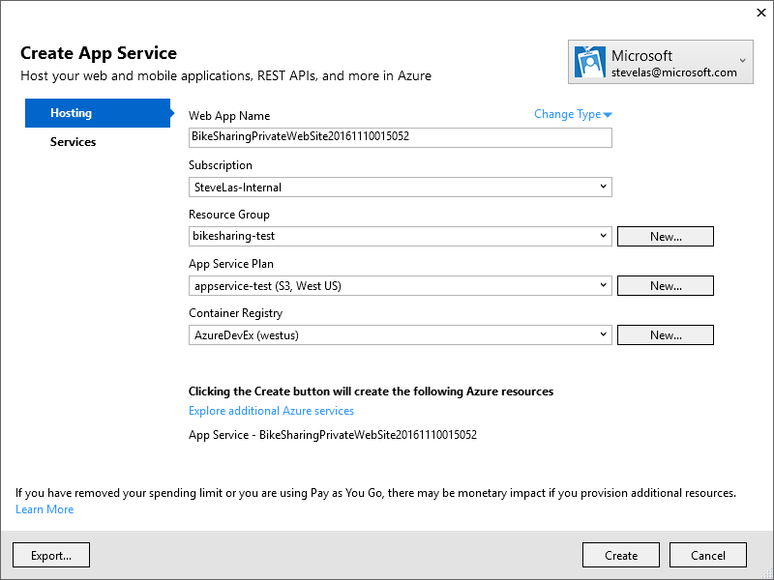

Slide 8
